Slide 1
Text Analysis and Machine Learning Workshop
Jason Kiley
Oklahoma State University
Part 3: Data Handling

Slide 2
github.com/jtkiley/

Slide 3
Data management
Using common datasets.
Gathering content data: web scraping, APIs, and commercial databases.
Merging and querying.
Practical advice.

Slide 4
Using datasets

Slide 5
Using datasets
Many times, we start a study that uses content analysis by gathering a sample from commercial databases like Compustat.
We can use information in those databases to help us retrieve content data.
pandas gives us very strong data reading and handling tools.

Slide 6
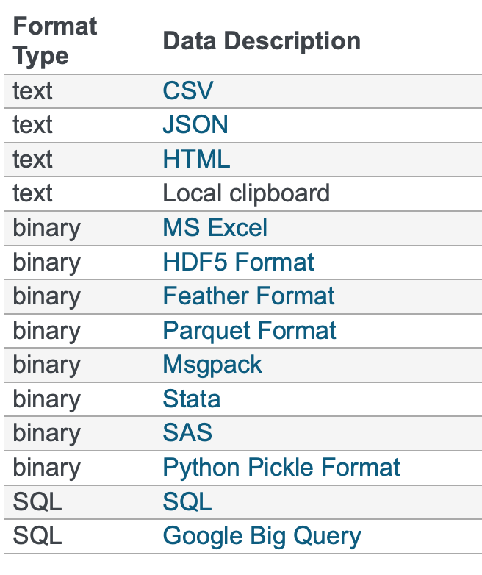
Reading data
pandas supports all of your favorite formats: csv, Stata, SAS, and so on.
It also reads difficult files (like fixed width files) quite well.
In many cases, it handles larger datasets than commercial tools.

Slide 7
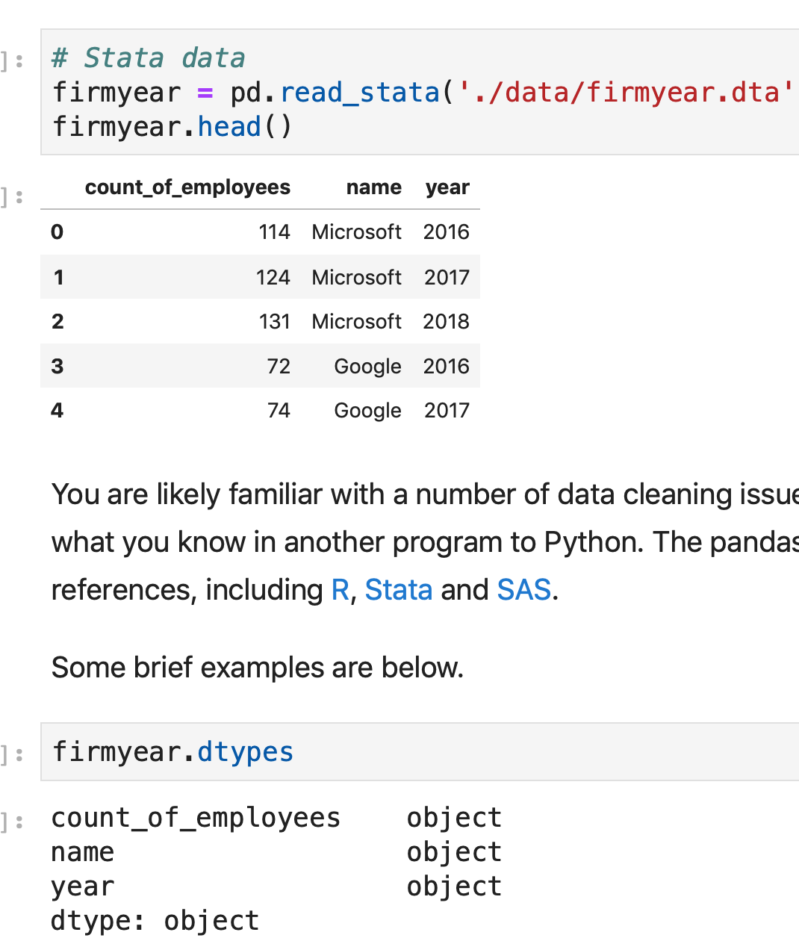
Data preparation
pandas is also quite good at data preparation.
Clean, aggregate, and transform data.
Generate lists for further data collection.

Slide 8
Gathering content data

Slide 9
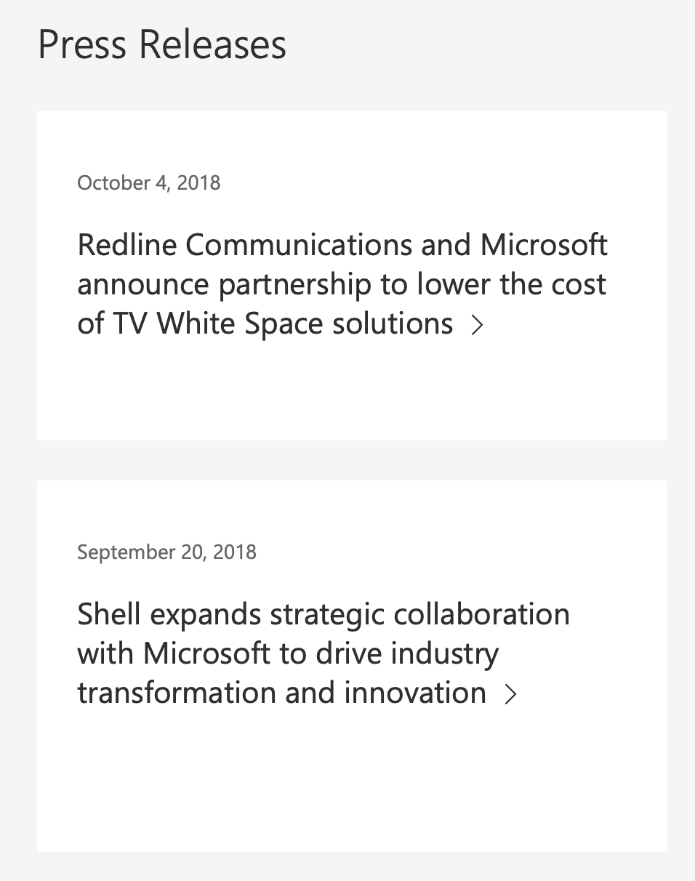
Web scraping (part 1)
Identify a website with data you want.
Automate the downloading of pages.
Parse out the data from the HTML.
We often use urllib and Beautiful Soup.

Slide 10

Web scraping (part 2)
Some sites dynamically load data or require interaction.
In these cases, we use code to automate an actual web browser.
We generally use selenium, and it’s like magic.

Slide 11
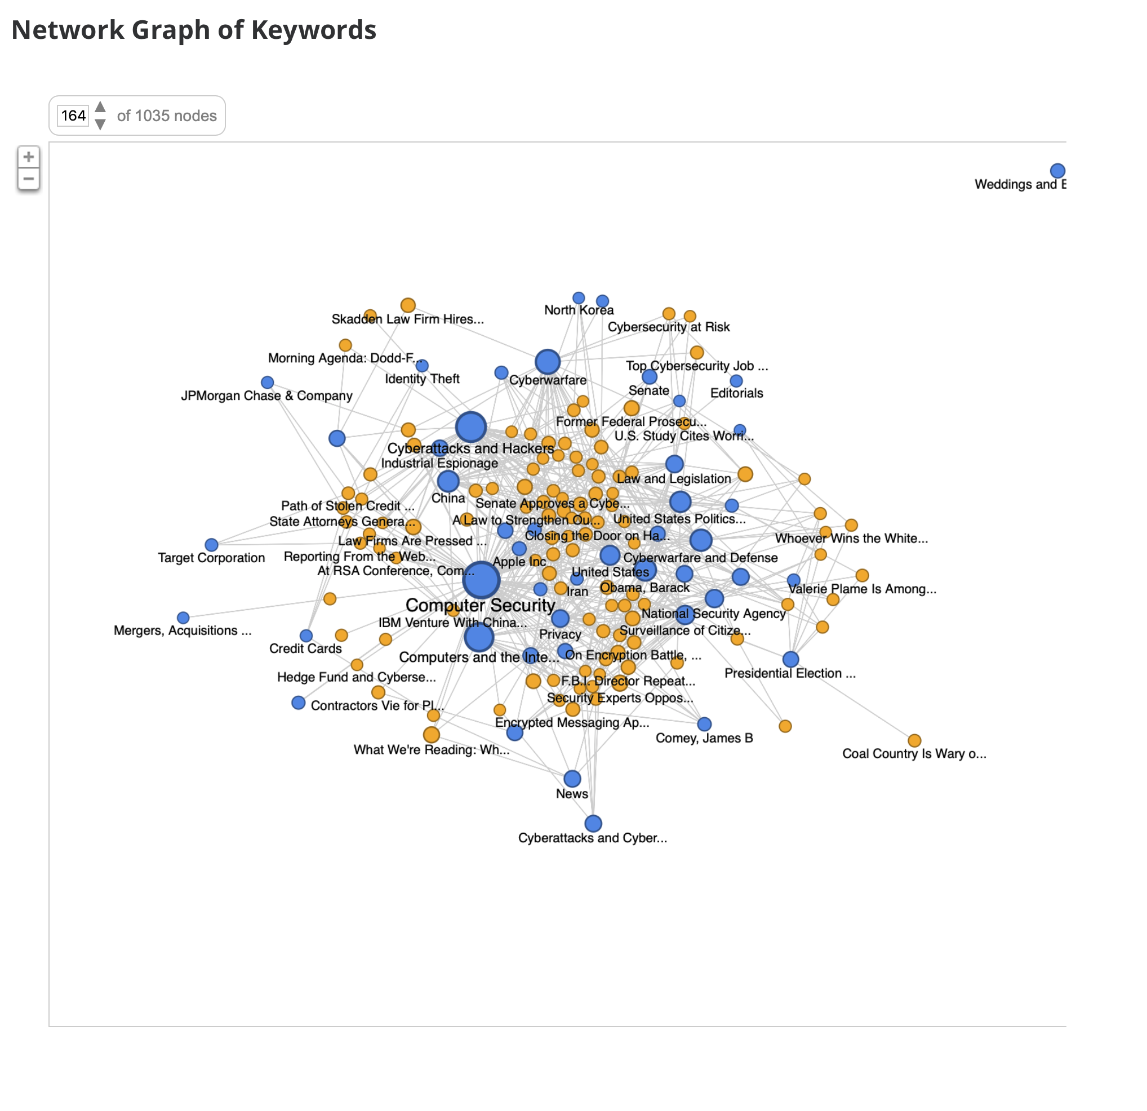
APIs
Application programming interfaces (APIs) are services that are designed to help us access data.
Examples: New York Times, Twitter.
Often charge for, and meter, access and require keys.

Slide 12
Commercial databases
Commercial databases often have data that is hard to access otherwise.
Examples: LexisNexis and Factiva.
They often have terms against web scraping, so you may want to use student assistants to gather data.

Slide 13
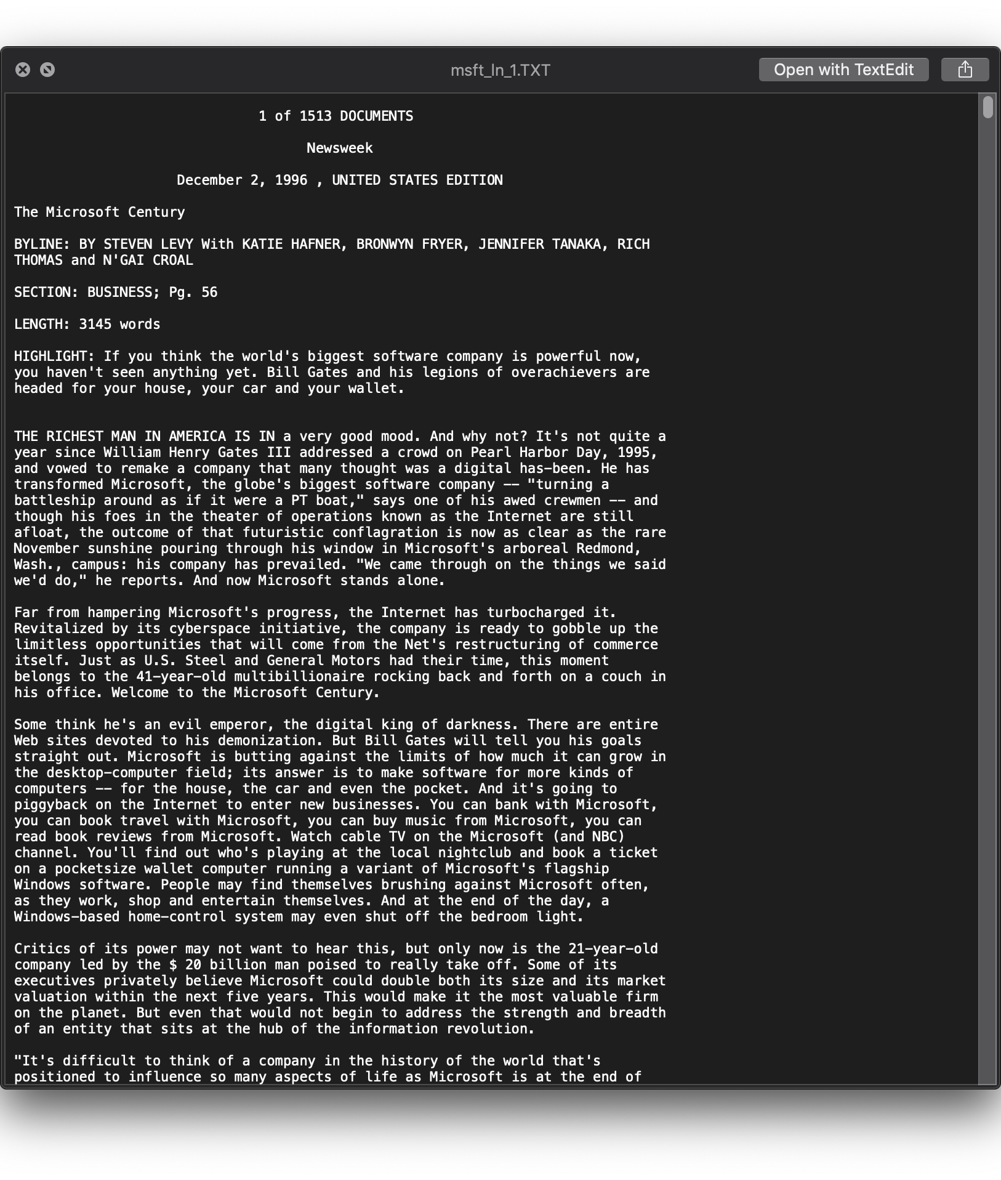
Semi-structured data
An issue with some commercial sources is that they return semi-structured results.
That means we can see the structure, but the computer can’t (without help).
I have a private package for LN and Factiva that I hope to open source.

Slide 14
Merging and querying

Slide 15
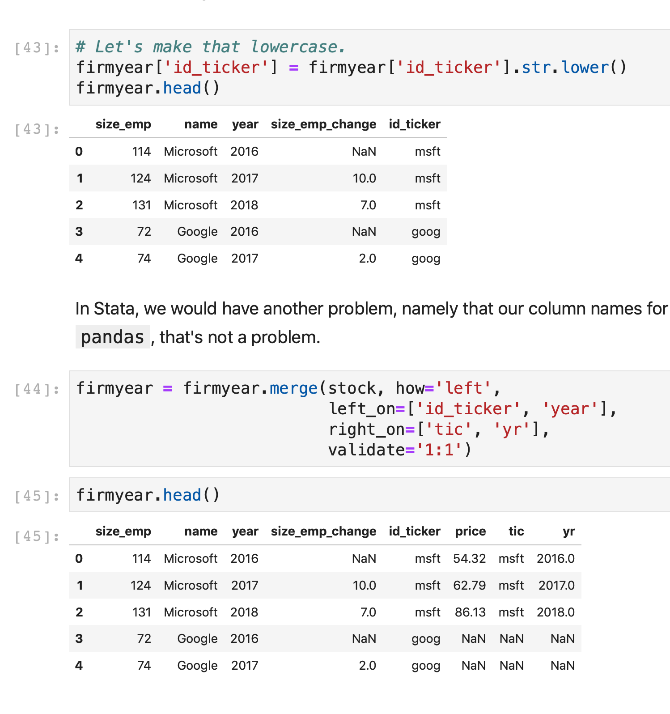
Merging
Like other software, pandas supports merging in a variety of ways.
It also has some conveniences not present in other software.
Support for many datasets at once.

Slide 16
Merge types
Left
Right
Left

Slide 17
Merge types
Left
Right
Right

Slide 18
Merge types
Left
Right
Outer

Slide 19
Merge types
Left
Right
Inner

Slide 20
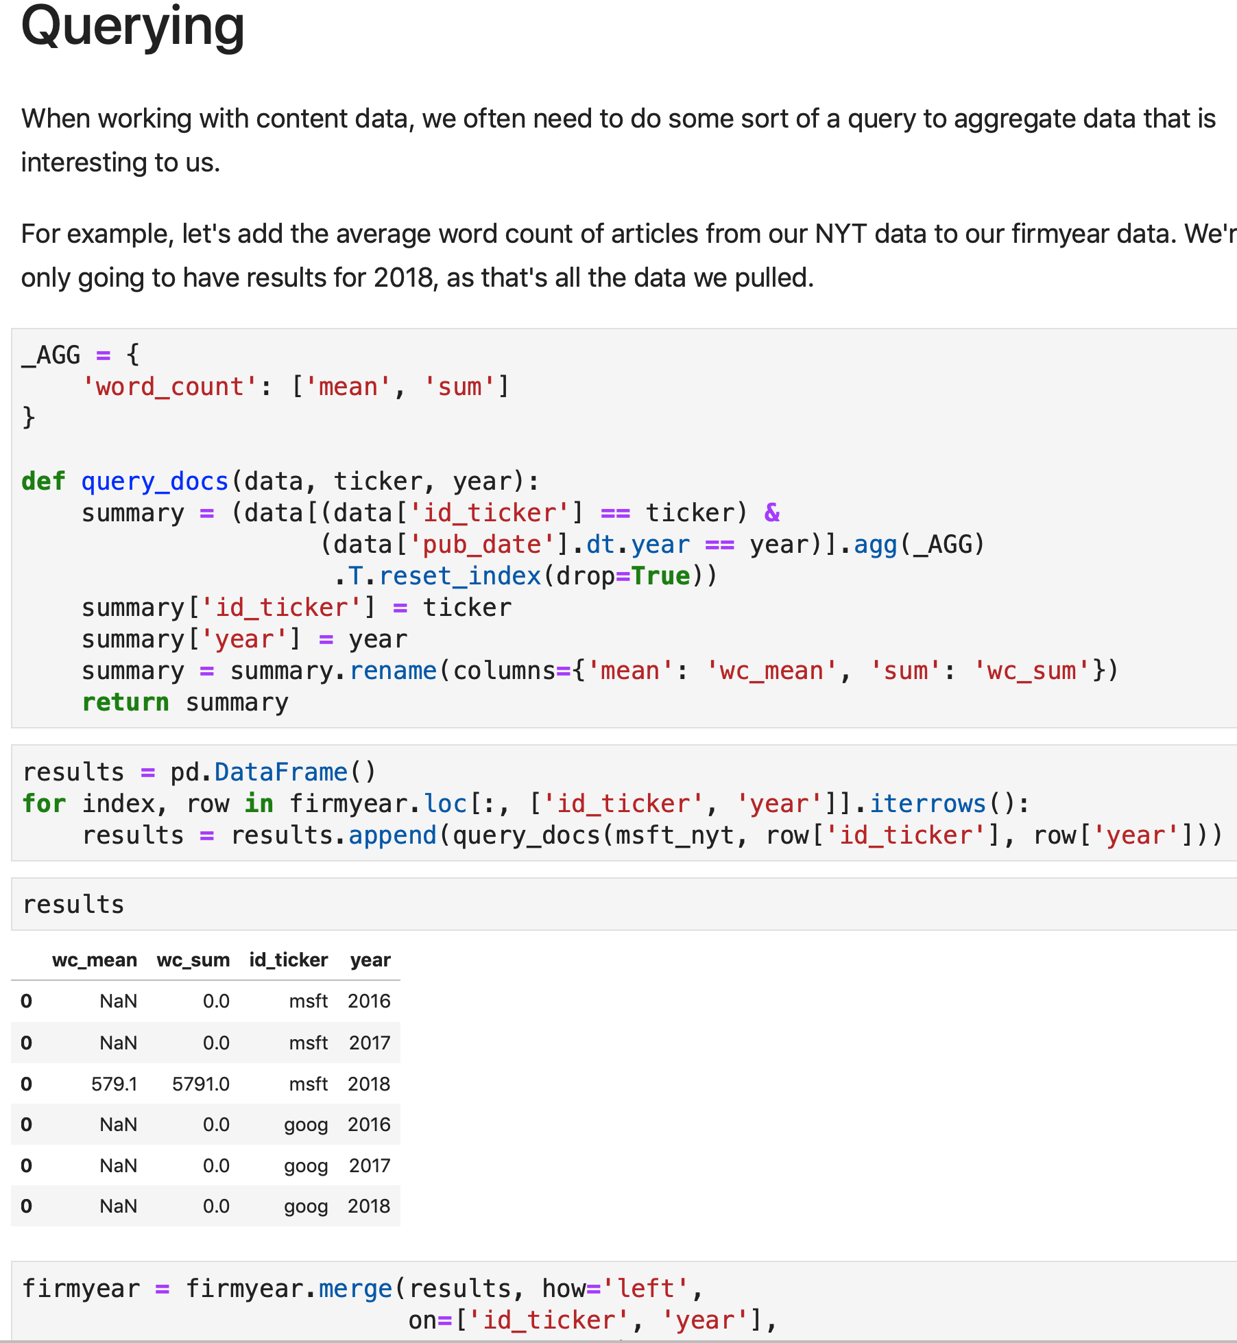
Querying
With content data, we often have to query the data to match it to our sample.
We often summarize it along the way.
pandas allows advanced queries that are hard to do with other software.

Slide 21
Practical advice

Slide 22
Measure twice, cut once
Planning is time well spent. Some gathering projects are labor-intensive or have costs in proportion to use.
The more salient those issues are, the more you want to minimize the amount of over-gathering.
Use pilot studies to test your protocol to make sure it works, gets the right content, and produces reasonable measures.

Slide 23
Explicit protocols
Write out explicit instructions for each role of the collection, and make them accessible to people in those roles.
That includes a checking protocol to make sure the data matches specifications.
This comes in handy for ensuring consistency (making the programming needs easier) and for writing up your methods.

Slide 24
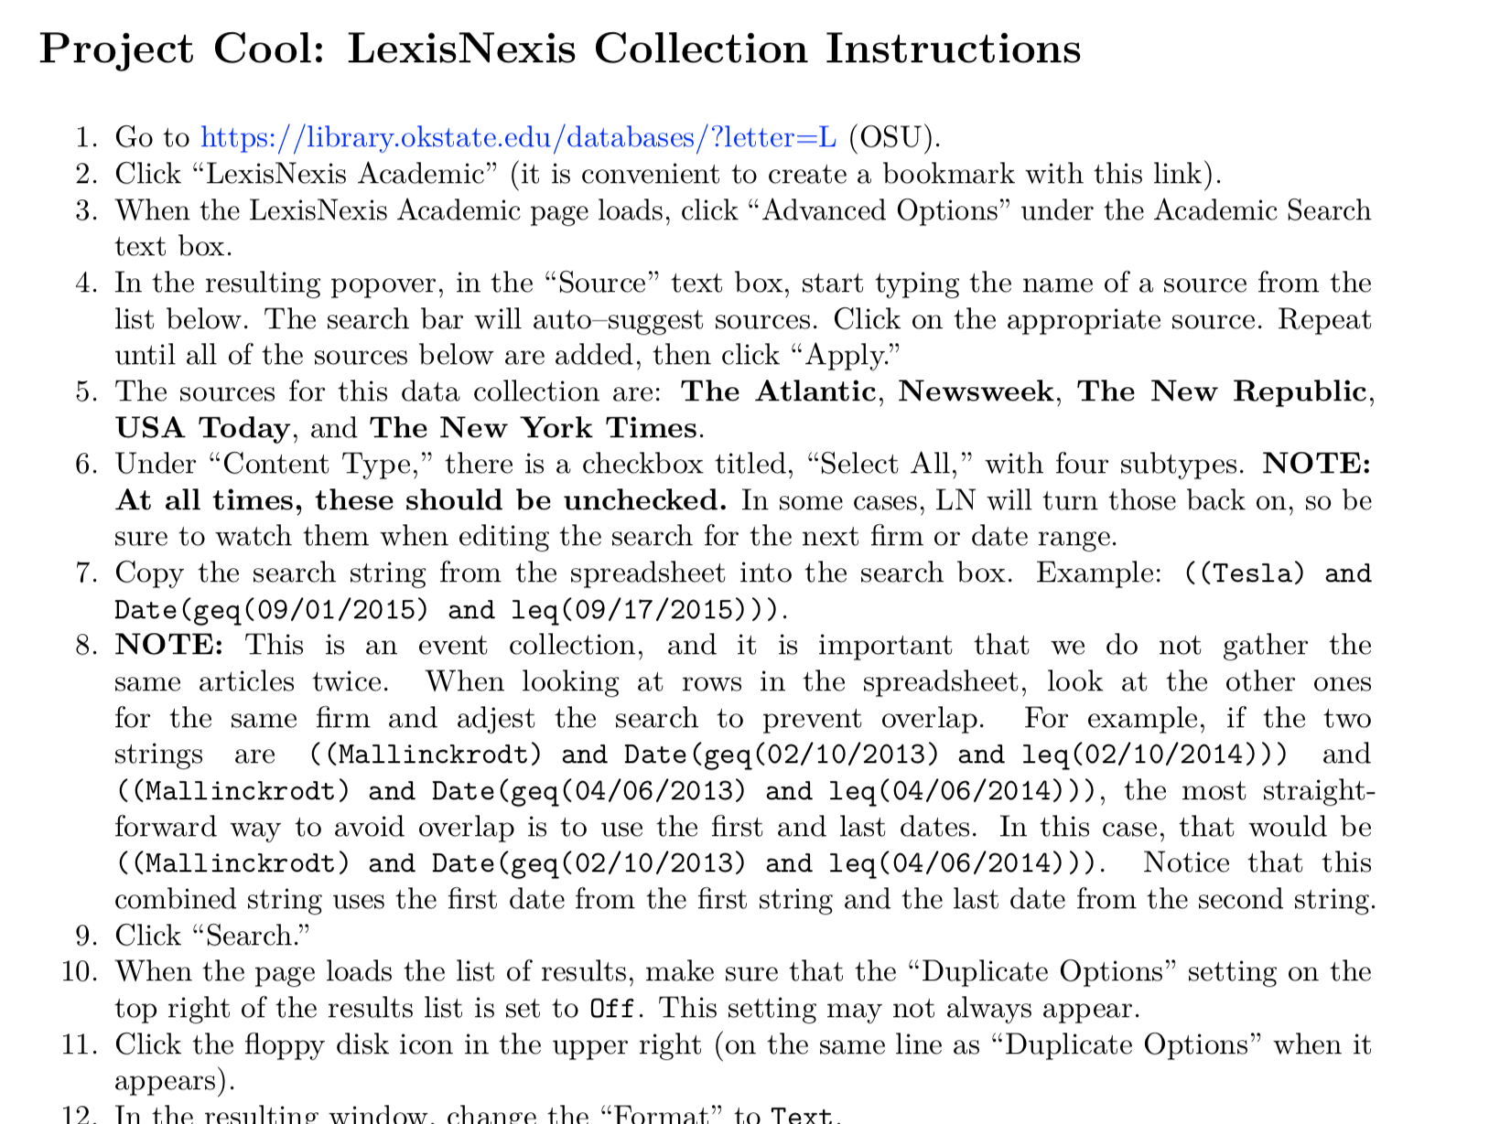

Slide 25
Test assumptions
Sometimes we make assumptions in sampling. For example, we might assume that firms under a certain size or not on a large cap index have little news coverage.
That may well be valid, but it is also something we can test.

Slide 26
Random subsets
Sometimes our ideal measure is too much data for some constraint that we have.
Consider gathering a random subset (e.g. 5 to 10 percent) to later test.
My 2016 AMJ: we were able to use a three-month control because it was highly correlated with six- and 12-month measures. It was about 30 percent of the size of 12-month data.

Slide 27
Hands-on
Reading and cleaning data.
Web scraping.
APIs
Commercial databases.
Merging and querying.

Slide 28
Hands-on

Slide 29
Summary
pandas can handle your entire data pipeline, and it’s often much better than stats software.
We can gather text data from a number of sources, and each has different challenges.
Planning and testing are key steps in conducting a study with content analysis. They are among the highest ROI tasks in the pipeline.

Slide 30
Questions

Slide 31
Break until 14:00

